Slide 1



Department of Computer Science and Engineering
MAJOR PROJECT PRESENTATION
Project Title: Controller of Examination Module
Guided By:
Dr. Shalini Kapoor
Presented By:
Sneha Aggarwal (2000290120161)
Notes:
1

Slide 2

CONTENT
Introduction…………………………………………......................................3
Abstract………………………………………………………………………...4
Objectives……………………….…………………….....................................5
Literature Review……………………………………..................................6-8
Methodology/Planning of Work……………………………………….……9-10
Implementation……………....………………............................................11-13
Facilities required for proposed work…………………………….……..........14
Expected outcomes…………………………………………………………....15

Slide 3
INTRODUCTION
Controller of Examination module is especially designed for automation of various processes involved in Examination Cell such as Preparation of Exam Date sheet, Seating Arrangement, Invigilation Duty Chart, Attendance and UFM. This system deals with these processes of exam online instead of manually. This application will be used for the automatic seating arrangement of seats based on number of students, number of classes and number of benches in a class, along with the preparation of invigilation duty chart based on the number of faculty available and number of rooms required as per seating plan. The COE module is designed which will update the details and display location of seat, where a dedicated person is required to fill in information, upload the data to the server where a real-time server updates all the data and students can know their location automatically as it will be reflected on their ERP portal. The examination hall allocation system is a web-based totally application that can be utilized in any school and college.

Slide 4
ABSTRACT
This Controller of Examination module has been advanced for the college, to simplify the manual processes. It helps get admission to the examination facts of a selected pupil in a particular magnificence. The reason for developing this exam block allocation gadget is to provide a way to allocate exam halls for every scholar with no conflict. Maximum students are dealing with many problems locating the examination corridor, so a newly invented idea enables the schools to generate their exam hall arrangement without difficulty. This challenge also allocates a selected invigilator for a particular corridor. It's also very beneficial for the college in that the software can also generate corridor separation and concerning reviews. Hence guide Excel sheets and office work are computerized based totally on their departments and registration numbers. The examination hall allocation system is a web-based totally application that can be utilized in any school and college. The exam corridor allocation is mostly a time-eating procedure. The exam controller has to select the blocks based on a particular scholar’s branch and the electricity of every block. sooner or later, this selection allows college students to discover the exam halls with no confusion. Also, the exam controller can save all the facts of the hall allocation technique for future reference in the use of this software.

Slide 5
OBJECTIVES
To Automate Exam Management Tasks: Automate scheduling, student registration, hall allocation, and invigilator assignments to reduce manual work and potential errors.
To Provide Real-Time Access to Information: Offer students, faculty, and administrative staff easy access to examination schedules, hall allocations, and other relevant information.
To Improve Administrative Efficiency: Streamline the examination process to save time and resources, allowing staff to focus on other critical educational tasks.
To Support Environmental Sustainability: Reduce paper usage by digitizing exam related documentation and processes.

Slide 6
LITERATURE REVIEW
Name of the paper: Exam Hall Seating Arrangement System
Authors: Prof. S. S. Aravinth
Description: The paper most important goal for developing this software program is to computerize the traditional way of carrying out exams.
Name of the paper: Automated Supervision Allocation System
Authors: Prof . Gautami G. Shingan
Description: The paper introduces a gadget which used for college leave management. The faculty who are allocated the supervision but for any because they're now not present at that time then the to be had faculty is sent mails for the supervision.

Slide 7
Name of the paper: Automation of Exam Hall Allotment and Seating Arrangement
Authors: Shazia Anjum, Madhuri
Description: This challenge allows in the technology of stories of seat preparations made and helps in producing random order of precise path or segment exams in every week.
Name of the paper: Examination Hall and Seating Arrangement Application using PHP
Authors: R.Gokila, Antony Rohan Das
Description: The paper describes system is evolved to generate the examination corridor seating arrangement for students efficaciously. The advanced machine is helpful for each group of workers and college students.

Slide 8
Name of the paper: Impact of Automation on Academic Examination Management
Authors: Kumar, R. & Singh, M
Description: The study includes case studies from various universities that have implemented automated systems for exam management. Explores the impacts of introducing automation into the examination management process, including efficiency, accuracy, and stakeholder satisfaction.

Slide 9
METHODOLOGY/ PLANNING OF WORK
Entry of exam hall details
Entry of Student Subject Details
View Exam Hall details
Preparation of Invigilation Duty Chart
Student Attendance through software

Slide 10
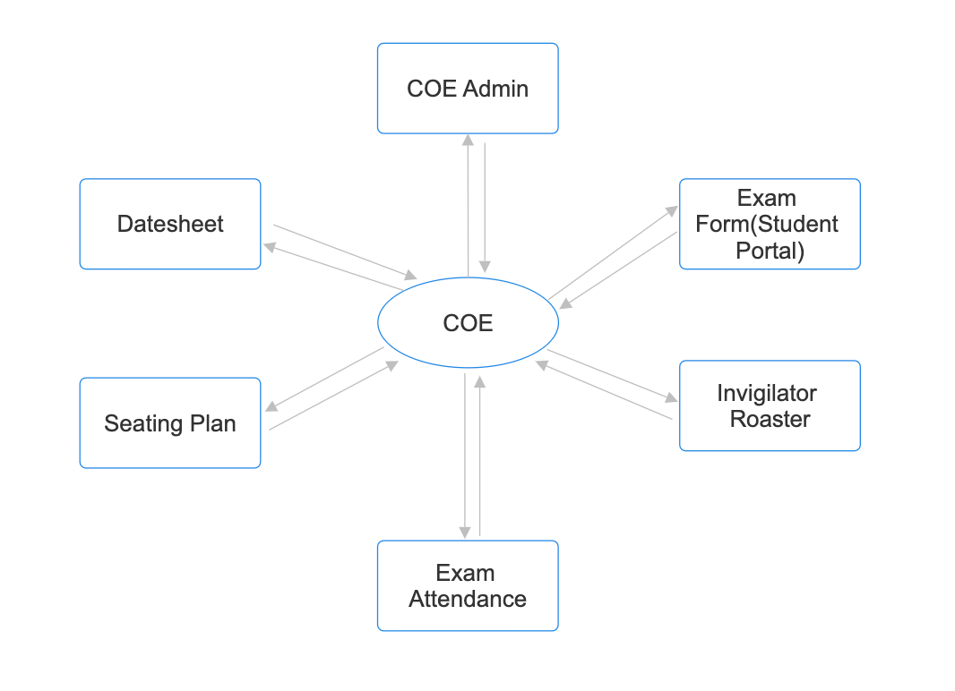

Slide 11
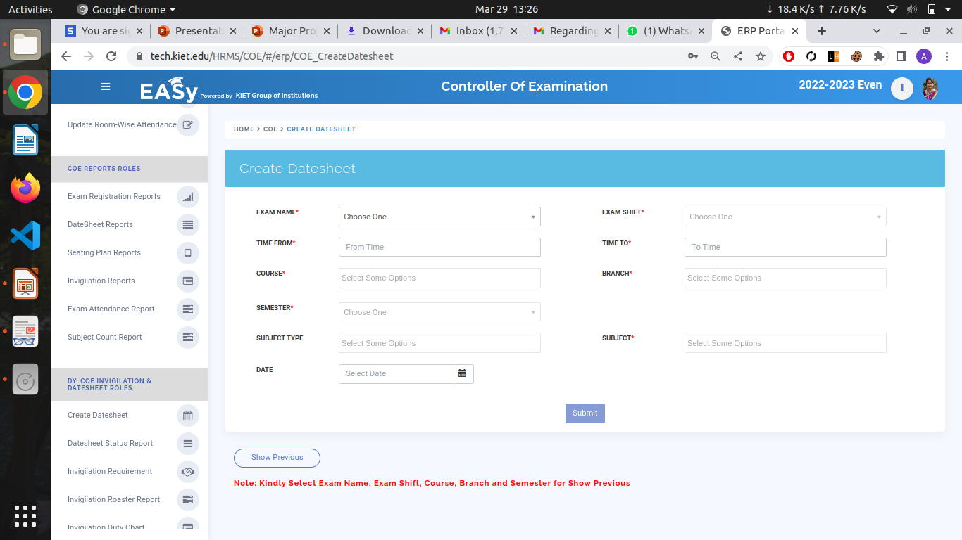
IMPLEMENTATION

Slide 12
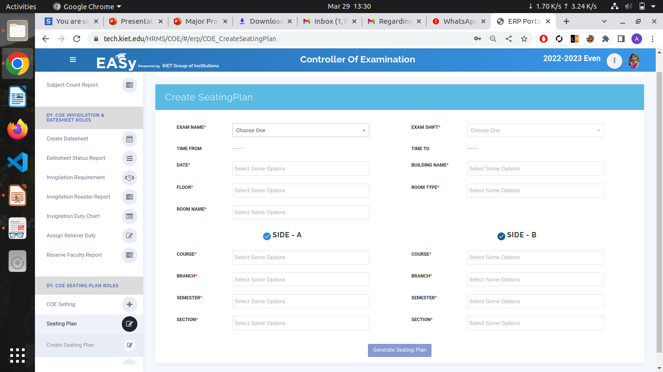

Slide 13
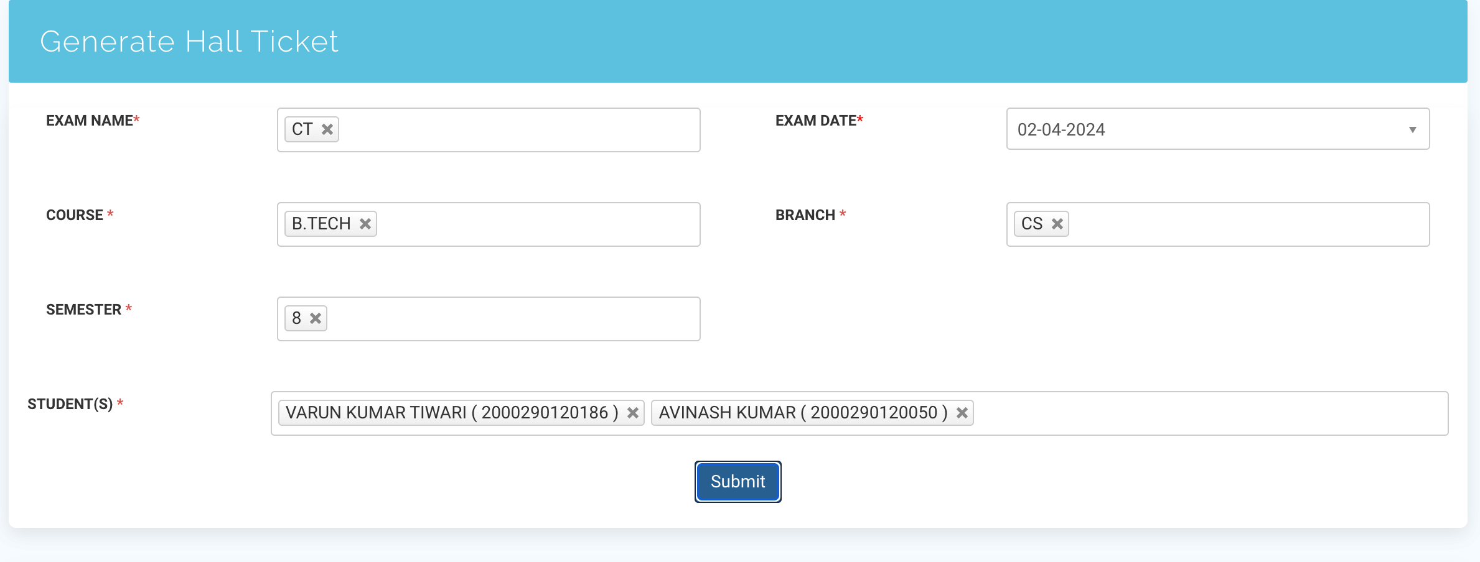

Slide 14
FACILITIES REQUIRED FOR PROPOSED WORK
SOFTWARE REQUIREMENTS
Operating system: Windows, Linux
Coding Language: Python, HTML, CSS, JavaScript
Frameworks: Django, Angular JS, React JS, React Native
Database: MySQL

Slide 15
EXPECTED OUTCOMES
Existing system is very slow and inefficient. There is a lot of manual work involved in current system and mistake in one detail can lead to incorrect generation of report. This system is to enhance manual work and more energy is wasted to allocate the seating arrangement. The existing invigilator allotment system in the universities and colleges under consideration have few problems like time and manpower needed for checking the availability of invigilator and generating the report. Besides, it is always impossible to reach the optimum assignment by solving the problem manually. This module assists in automating the existing manual system. The data which is stored in the repository helps in taking intelligent decisions by the Controller of Examination department. The proposed system can be extended making use of containerization technology to increase scalability and reliability. With the help of cloud computing, the proposed system may be extended to improve portability thus handling multiple organizations at once.

Slide 16
THANK YOU

